Slide 1
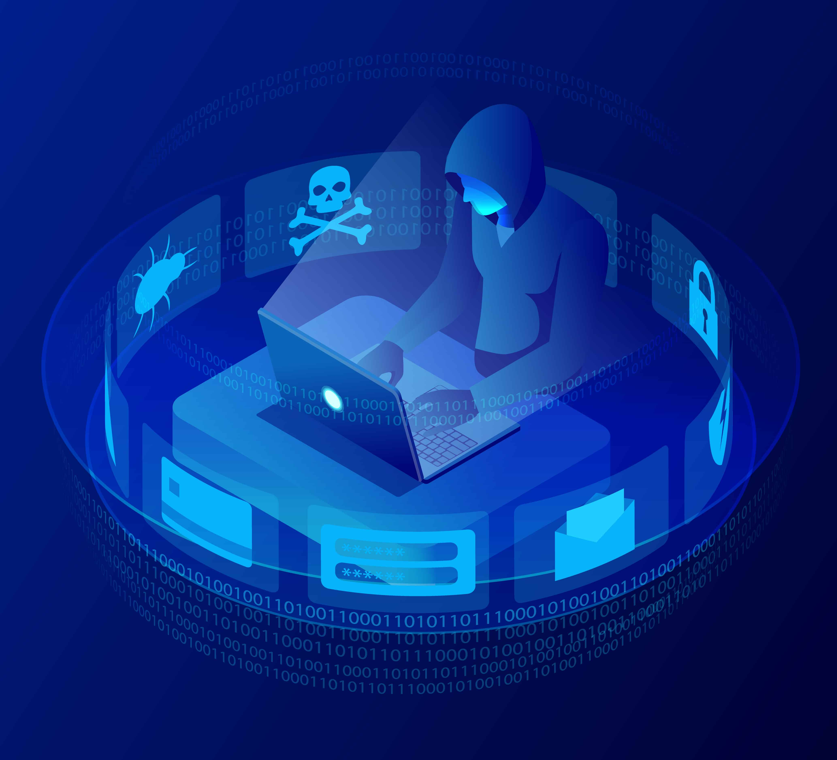
New England Hospital Security
An assessment of the New England Hospital overviewing:
- Security issues
- Vulnerabilities
Mitigation strategies
(Talk about what it is, 1st of its kind, opened Maidstone Kent, 4 may 2022 services for covid and provides 300 beds for rehabilitation)

Slide 2
Hospital IT Infrastructure
(Services operating on)
Workstations using Windows 8 or 10
Servers working on Windows 2016, 2019
Legacy Windows XP systems
Online Web Services via Internet to access records
(Patient Information held on)
Linux based SQL servers
J2EE Java Glass Fish application servers
(Login system built through Java Resource Adapter Architecture)
Active directories, web servers, SQL databases

Slide 3
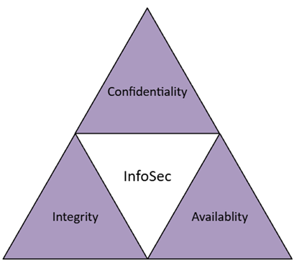
Why Security is Needed?
Information security (InfoSec) is the protection of both physical and digital information against unauthorised access, disclosure and disruption/alteration. (IBM, 2024, What Is Information Security? | IBM)
Why is infoSec important?
Prime target for attacks due to
value and importance (NHS Synnovis Ransomware Attack, up to 300 million records including patient data were stolen, June2024)
Keep data secure (and protected
against internal or external damage)
Reduce Risk of security breaches
Mitigate and remediate damage in
case of breaches
Maintain the principles of CIA
(Foundational to InfoSec, what it means?
preventing unathorised access
Preventing tampering to ensure authenticity and
reliability, data available when needed by authorised personnel in org)

Slide 4
Industry Standards
(2 primary recognised standards which help validate a companies proficiency in the InfoSec field)
ISO/IEC 27001
- Provides guidance for improving ISMS (Information Security Management System)
- Provides a centralised framework
- 5 steps of implementation
- Provides certification is known universally for quality
NIST SP 800/30
- Alternative to ISO/IEC 27001
- Provides a Risk assessment guideline
-6 Steps to conducting a risk assessment
In this case, NIST SP 800/30 has been used primarily
Report has worked primarily on cyber risk and threat
Management without the certifation standard that ISO requires
Define Scope and Objectives
Conduct Risk Assessment
Implement Security Controls
Monitor and Review Performance
Continuous Reiteration and Improvement
Identify Threat Sources
Identify Threat Events
Identify Vulnerabilities
Determine Likelihood of Threat Event
Determine the Negative Impact of Threat Sources
Determine Risks via the calculation (Likelihood x Impact)

Slide 5
Risk Assessments
Risk assessment was developed via online research on vulnerabilities within systems using CVE as the source.
The source of the risk and results of the vulnerability were elaborated

Slide 6
Risk Matrix
Windows Server 2016, 2019 and Windows 8 are old systems (End of Life) No support due to lack of updating to protect against new vulnerabilities, replace as soon as possible
Threat of Spoofing

Slide 7
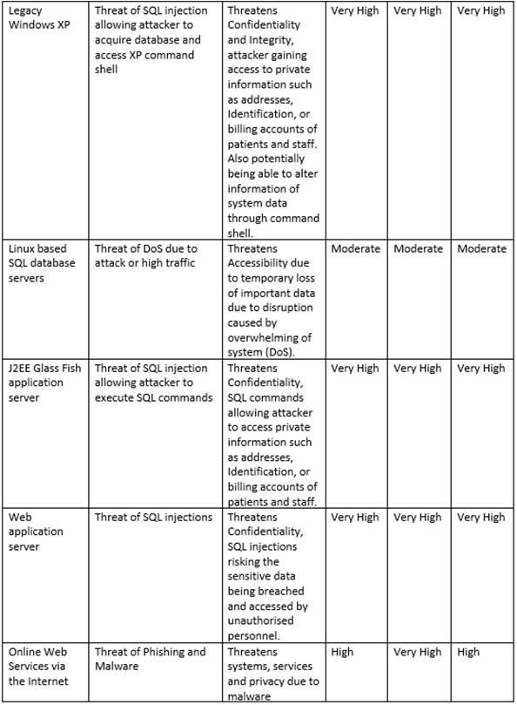
Risk Matrix
Legacy Windows XP is an End-of-Life system (no more support, however legacy systems are normally critical systems and essential to fulfil organisation needs)
SQL injections and DoS attack threat
Phishing threat

Slide 8
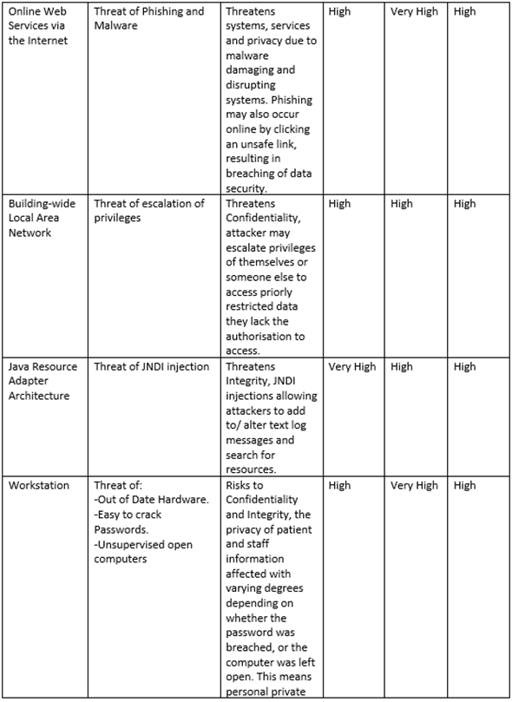
Risk Matrix
Threat of escalation of privileges and JNDI Injection
Outdated softwares.

Slide 9
Risk Matrix
Weak log-ins and their systems
Verbal sharing of potentially sensitive data
Physical access vulnerability

Slide 10
Identified Issues
End of Life
Lack of Firewalls
Lack of 2FA
Insufficient Security and Access Control
Lack of Antivirus
Lack of Encryption
Lack of Network Segmentation
These issues are easily solveable via the implementation of the lacking systems and the updating and improvement of current systems

Slide 11
Penetration Testing
Kali Linux (Open source, modular and over 300 tools preinstalled for exploiting)
nMap & Metasploit (Network scanning Windows 10 allowing Metasploit) (Windows exploit via EternalBlue)
TheHarvester (Sniffing data, acquiring emails, domains, hosts etc)
ShellPhish (Phishing to take input logins from mimic site)
SQL Map (SQL Injections to acquire database info)
OpenVAS performs vulnerability scans and makes reports

Slide 12
Potential Damages
Legal repercussions for not following guidelines (report breaches to supervisory authority with 72 hours Personal data breaches: a guide | ICO)
Fines (17.5 million or 4% of total turnover Penalties | ICO) (eg British airways got a 20million fine)
Loss of Data
Loss of Credibility, Trust and Reputation (If theres been a breach and people have been affected, they are less likely to trust the organisation and use it)
Damage to Systems
Danger to Patients and Staff (Malicious Characters holding private data which may be used for ransom, Impersonation, fraud)

Slide 13
Mitigation Strategies
Upgrade to New Systems
- e.g. Windows Server 2022 and Windows 11 (these may require higher specifications on hardware that the old hardware may not have, as a result having to upgrade hardware (cost)
- Have better security protection and features to mitigate threats
- Can help resolve and mitigate risks relating to End of Life and Legacy
Implement Firewalls
- Protect network against unauthorised access via controlling network traffic
- Protects against SQL Injection, Heap-based Buffer overflow, Malware, DoS/DDoS, Brute-force attack

Slide 14
Mitigation Strategies
Implement Two Factor Authentication / External Approval System
- Access requires two levels of identification
- Protects against Phishing, Brute-force attack, Keylogging
- If Login info is breached, the threat is reduced as second clearance is required
Improve Security and Access Control
- Restricting access to resources via regulating who can view resources based on clearance/role
- Protects against Unauthorised access, Privilege escalation, Brute-force attack, Phishing

Slide 15
Mitigation Strategies
Implement Antivirus
- Scans system for viruses and other digital threats and eliminates them
- Protects against Malware
Implement Encryption
- Converting plaintext into ciphered text which makes it unreadable without the decryption key (only the two intended users have access to the keys)
- Protects against Brute-force attacks, Phishing, Man-in-the- Middle, SQL Injection, DoS/DDoS

Slide 16
Mitigation Strategies
Implement Network Segmentation
- Divides network into smaller isolated networks
- Limits damage by restricting damage to only the breached segment It doesn’t Protect in a similar way to other strategies,
Implement Packet Filtering
- Passes and blocks data packages based on IP source, ports and protocols
- Protects against DoS/DDoS, Malware, Spoofing

Slide 17
Mitigation Strategies - Human Elements
Human Elements – Gossip
- Implement Consequence Management System
- Educate staff on Information Security and data privacy
Human Elements – Phishing Links
- Educate staff on Information Security and data privacy
- Educate staff what phishing is and what to look out for
- Implement scanners to check and warn staff about dangerous links
Human Elements – Removeable Media
- Block access to ports and use of external devices
- Educate staff on Information Security and data privacy

Slide 18
Cloud Computing
What is Cloud Computing?
The use of remote servers via the internet (as a host) to handle and manage data
Why to move to Cloud Computing
Flexibility (quick to adapt to changes), Efficiency (reduce operational costs) and Innovation (adopts new tech faster)
Inbuilt Security and security expert associates in provider orgs
Disadvantages of Cloud Computing
Reliant on internet connectivity (if there is an outage, these risk to accessibility, however in the world based and reliant on the internet, this risk will naturally reduce)
Expensive upfront investment and maintenance

Slide 19
Cloud Computing
3 Main Cloud Platform Providers: (Which are gdpr compliant)
Amazon Web Services (AWS)
- Offers a wide scale of security services such as encryption and Monitoring and Logging
Microsoft Azure
- Provides a wide scale of security tools similar to AWS but also provides tools suck as Identity and Access Management (IAM)
(IAM manages user identities and access permissions) (currently used by NHS)
Google Cloud Platform (GCP)
- Specialises in data encryption and analytics

Slide 20
Cloud Computing - Migration
Moving resources from onsite storage (servers) to cloud storage platforms
1st list your resources, systems apps data
2nd purpose
3rd choose platform AZURE
4 pick a migration approach from the 6 Rs approach (MAKE A PP ON 6R
5th Make a incremental plan , not move everything at once, high risk!
6th Train team
7th Monitoring

